Slide 1
Digital portfolio 2025

Slide 2
Introduction To myself
STUDENT NAME:FIRTHOUES BANU.M
REGISTER NUMBER AND NMID:24131061802522016 AND autanm106106cs214012
DEPARTMENT:BSC. COMPUTER SCIENCE
COLLEGE:SHREE RAGHAVENDRA ARTS AND SCIENCE COLLEGE CHIDAMBARAM ANNAMALAI UNIVERSITY

Slide 3

Project title
Digital portfolio

Slide 4
Agenda
1.Problem Statement
2.Program overview
3.End users
4.Tools and technologies
5.Portfolio design and layout
6.Features and functionality
7.Result and screenshot
8.Conclusion
Notes:
1.Problem Statement
2.Program overview
3.End users
4.Tools and technologies
5.Portfolio design and layout
6.Features and functionality
7.Result and screenshot
8.Conclusion

Slide 5
Problem statement->
Many students lack a structured platform to showcase their academic achievement,skills,and projects.
Traditional resumes cannot fully reflect creativity and technical skills
A digital portfolio helps represent work in an interactive,organized,and professional way
Notes:
Many students lack a structured platform to showcase their academic achievement,skills,and projects.
Traditional resumes cannot fully reflect creativity and technical skills
A digital portfolio helps represent work in an interactive,organized,and professional way

Slide 6
Program overview ->
The project is about creating a digital portfolio website It includes student details,skills, projects, certificates,and achievements The portfolio is accessible online , making it easy to share with recruiters or faculty
Notes:
The project is about creating a digital portfolio website
It includes student details,skills, projects, certificates, and achievements
The portfolio is accessible online, making it easy to share with recruiters or faculty

Slide 7
END USERS->
Students(for academic and job opportunities) Teachers and faculty(for evaluation) Recruiters and companies (to verify skills and projects)

Slide 8
Tools and technologies
⭐Frontend:HTML,CSS, Javascript Backend (optional):PHP/Node.js ⭐ Database (optional):MySQL/MongoDB Vision Control:Git & GitHub ⭐Design Tools:Canva/Figma for layout

Slide 9
Portfolio design and layout
👉Home page (introduction+ photo ) 👉About me (details, education,skills) 👉Projects (screenshots, descriptions, links) 👉Certificate & symbol achievements 👉Contact section (email,social links)

Slide 10
Features and functionality
1️⃣Easy navigation with menus 2️⃣Links to GitHub repositories
3️⃣Contact from integration 4️⃣Downloadable resume option

Slide 11
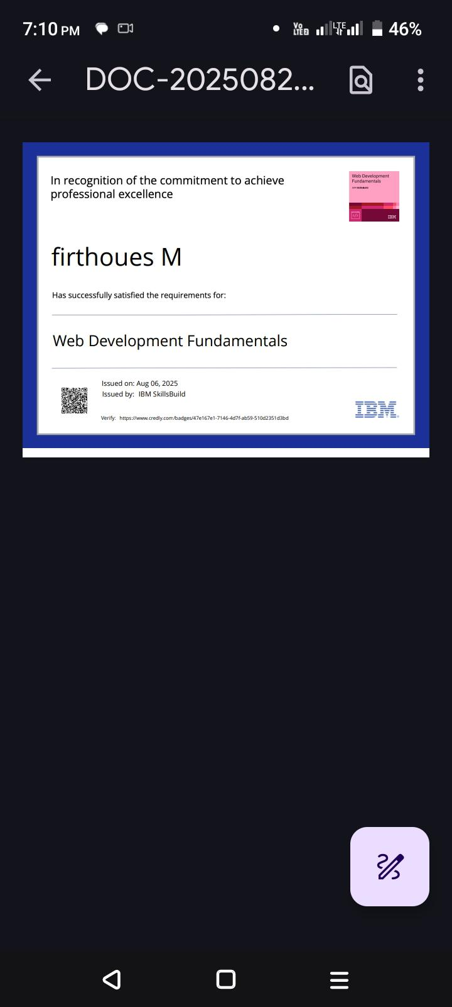
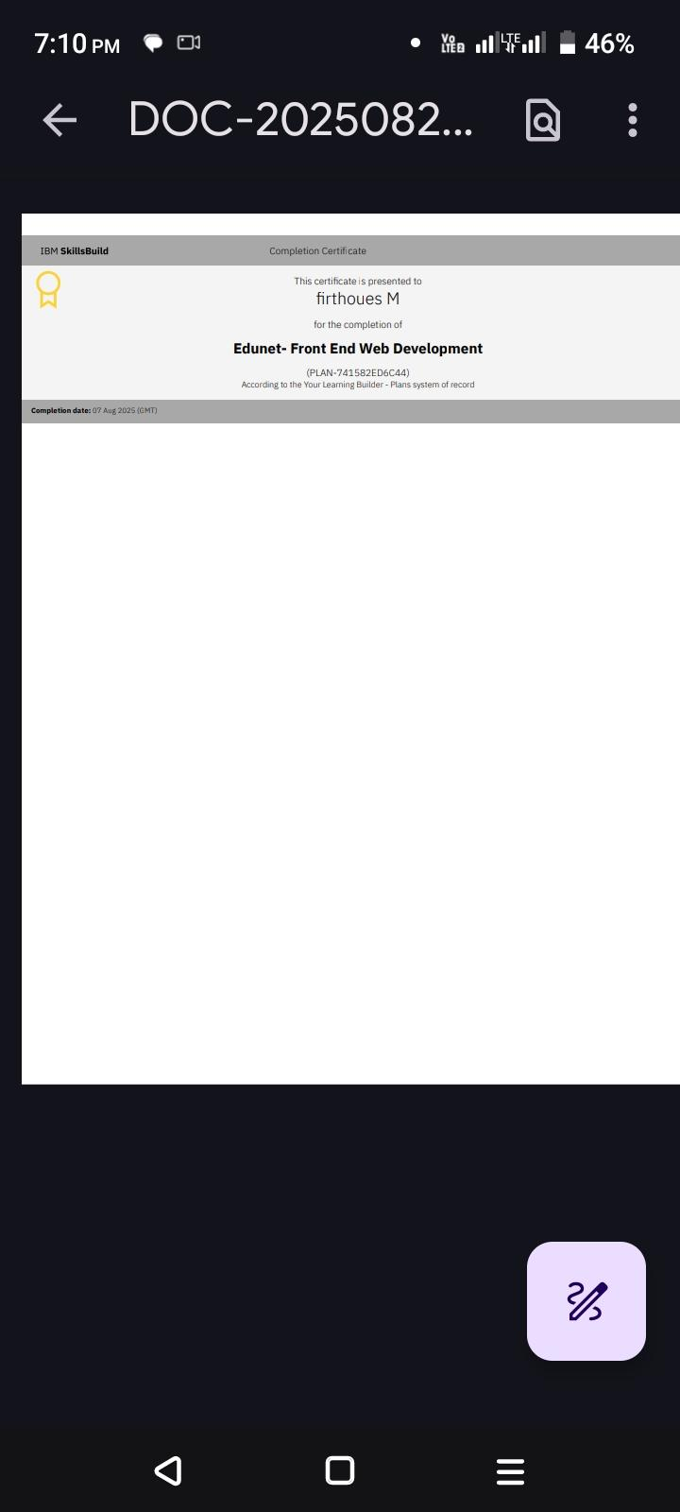
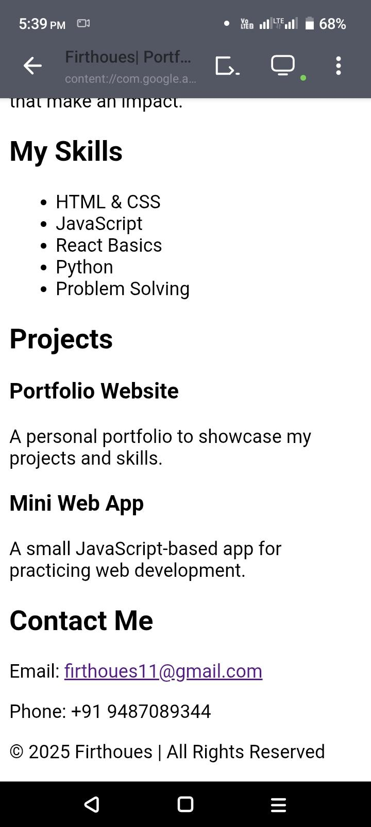
Results and screenshots

Slide 12
CONCLUSION

Slide 13
⭐Thank you ⭐
Notes:
⭐Thank you ⭐

